Slide 1
Data Communications for a Global Environment
Lecture 2:
The ISO Internet Model and Messaging thru Layers

Slide 2
Data Communications for a Global Environment
A Brief History of Centralized Software Development
and the evolution to Distributed systems
Impact of Moore’s Law:
- Gordon Moore observed that the number of transistors
on an integrated circuit had doubled every year since the
introduction of the IC and that trend would continue into the foreseeable future.
- Actually, it was closer to 18 months and in 1975 Moore modified it again to 24 months. Still despite all the theorists who predicted a quantum limit, the trend has continued for 4 decades.
In 1965, when Moore made his first prediction there were about 60 transistors on a chip. In 2008, Intel has put 1,700,000,000 Transistors on it’s Itanium chip.

Slide 3
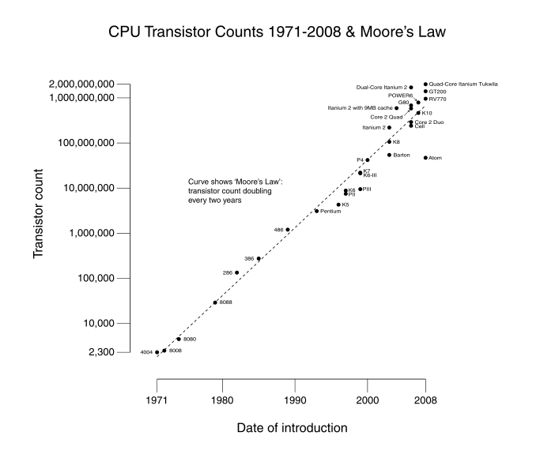
Moore’s Law

Slide 4
Data Communications for a Global Environment
A Brief History of Centralized Software Development
and the evolution to Distributed systems
Dealing with the Chaos
- The reemergence of the IT organization
- Year 2000 issue
- The emergence of Application Development methodologies
- Object Oriented Design
- The Internet Explosion

Slide 5
Data Communications for a Global Environment
A Brief History of Centralized Software Development
and the evolution to Distributed systems
1970
Present
Business more
Geographically
consolidated
Business Internationally
Diversified
Low Cost, Distributed
CPU capacity. System
Components loosely coupled
High Cost, Low CPU capacity
Tightly coupled Systems
Applications driven by
CAPEX considerations and
Algorithmic Efficiency.
Applications driven by
ROI, Marketing or Business
Advantage considerations
Networks barely existent
Providing File Transfer or
RTA over private lines
Internet providing a pervasive
World wide communication
Infrastructure.

Slide 6
Data Communications for a Global Environment
Why does MIS 340 Seem So Confusing?
Many technologies exist
No singe underlying Theory exists that explains all the relationships
among all the parts
Multiple organizations have created computer networks standards
Set of technologies is diverse and changes rapidly.
Terminology is inconsistent between researcher's trying to be
technically precise and Marketers who often invent new terms
to distinguish their products.

Slide 7
Let’s consider what a networking program would entail.
Data Communications for a Global Environment
Computer
Input: Human readable set of
characters
Applications
OS
Output: A series of electrical pulses
consisting of 1’s and 0’s that represent
the message and associated control
information.
7
1 - 7
Notes:
How are characters converted to 1’s & 0’s

Slide 8
Network Communication Software
Data Communications for a Global Environment
Single layer implementation
-Networking with large components is complex to understand and implement
Applications
Applications
OS
Communication
Communication
OS
8
1 - 8
1 - 8
Notes:
I f you were writing a communication program what are some of the functions would you need to consider?

Slide 9
Data Communications for a Global Environment
Exercise Scenario:
The Application program on system 1 has as its output, a number, which is represented as an 8 bit binary number. You want to store that output on a SQL database residing on system 2. Assume the two computers
have a compatible physical connection, There are no other computers on the network, no other application programs are running. You have been asked to write a communication program to transfer the output of system 1 to the database on System 2.
Assignment: Identify all the processes (functions) that have to be considered
Hint: think about similar patterns that may exist in other processes like the postal system.
9
1 - 9
1 - 9
Notes:
I f you were writing a communication program what are some of the functions would you need to consider?

Slide 10
Data Communications for a Global Environment
I f you were writing a communication program what are some of the functions would you need to consider?
What software program sent the data
What is the physical address you want to send it to
How do I tell the start of a message
How do I tell the end of a message
What software program am I sending the program to
Is the connection working
How do I know the message was delivered
What do I do if it is not delivered
Is there an error in the message
What do I do if there is an error in the message
transfer the data to the database
10
1 - 10
1 - 10
Notes:
I f you were writing a communication program what are some of the functions would you need to consider?

Slide 11
Data Communications for a Global Environment
Messaging thru Layers
Applications
Applications
Multi layer implementation
Breaking down into smaller components
Easier to implement
OS
OS
11
1 - 11
1 - 11

Slide 12
Multi-layer Network Models
Data Communications for a Global Environment
The two most important such network models: OSI and Internet
Open Systems Interconnection Model
Created by International Standards Organization (ISO) as a framework for computer network standards in 1984
Based on 7 layers
Internet Model
Created by DARPA originally in early 70’s
Developed to solve to the problem of internetworking
Based on 5 layers (not initially)
Based on Transmission Control Protocol/ Internet Protocol (TCP/IP) suite
12
1 - 12
1 - 12

Slide 13
Internet’s 5-Layer Model
Data Communications for a Global Environment
Physical Data Link Network Transport Application
“Please Do Not Touch Alligators”
Application Layer
Now incorporates the functionality of the presentation and Session layers application program
Transport Layer
responsible for establishing end-to-end connections, translates domain names into numeric addresses and segments messages
Network Layer – provides addressing and routing
Data Link Layer – provides message delineation, error control and Media Access Control.
Physical Layer - defines how individual bits are formatted to be transmitted through the network
13
1 - 13
1 - 13

Slide 14
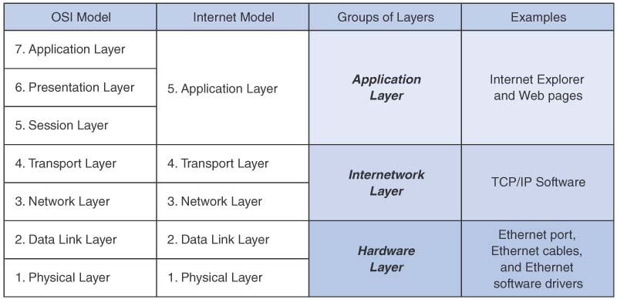
Comparison of Network Models
Data Communications for a Global Environment
14
1 - 14
1 - 14
1 - 14

Slide 15
Message Transmission Using Layers
Data Communications for a Global Environment
sender
receiver
Applications
Applications
A receiving layer wraps incoming message with an envelope
Adds layer related addressing information
A receiving layer removes the layer related envelope and forwards the message up
15
1 - 15
1 - 15
1 - 15

Slide 16
Protocols
Data Communications for a Global Environment
Used by Network model layers
Sets of standardized rules to define how to communicate at each layer and how to interface with adjacent layers
Layer N+1
Layer N+1
Layer N
Layer N
Layer N-1
Layer N-1
sender
receiver
16
1 - 16
1 - 16

Slide 17
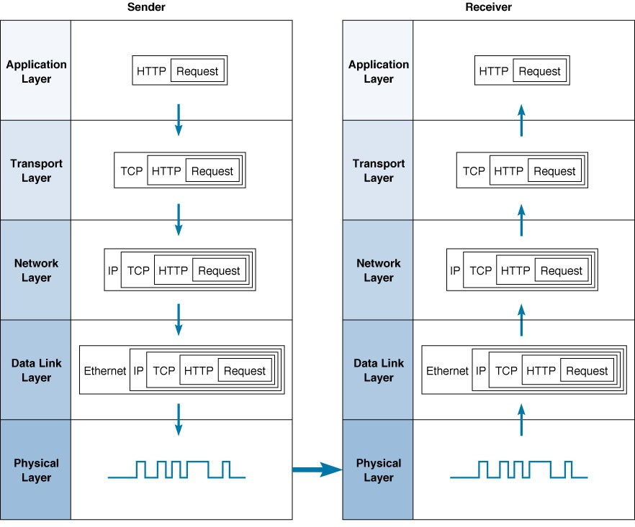
Message Transmission Example
Data Communications for a Global Environment
17
1 - 17
1 - 17

Slide 18
Points about Network Layer View
Data Communications for a Global Environment
Layers allow simplicity of networking in some ways
Easy to develop new software that fits each layer
Relatively simple to change the software at any level
Matching layers communicate between different computers and computer platforms
Accomplished by standards that we all agree on
e.g., Physical layer at the sending computer must match up with the same layer in the receiving computer
Somewhat inefficient
Involves many software packages and packets
Packet overhead (slower transmission, processing time)
Interoperability achieved at the expense of perfectly streamlined communication
18
1 - 18
1 - 18

Slide 19
Standards
Data Communications for a Global Environment
Importance
Provide a “fixed” way for hardware and/or software systems (different companies) to communicate
Help promote competition and decrease the price
Types of Standards
Formal standards
Developed by an industry or government standards-making body
De-facto standards
Emerge in the marketplace and widely used
Lack official backing by a standards-making body
19
1 - 19
1 - 19

Slide 20
Standardization Processes
Data Communications for a Global Environment
Specification
Developing the nomenclature and identifying the problems to be addressed
Identification of choices
Identifying solutions to the problems and choose the “optimum” solution
Acceptance
Defining the solution, getting it recognized by industry so that a uniform solution is accepted
20
1 - 20
1 - 20

Slide 21
Major Standards Bodies
Data Communications for a Global Environment
ISO (International Organization for Standardization)
Technical recommendations for data communication interfaces
Composed of each country’s national standards orgs.
Based in Geneva, Switzerland (www.iso.ch)
ITU-T (International Telecommunications Union –Telecom Group
Technical recommendations about telephone, telegraph and data communications interfaces
Composed of representatives from each country in UN
Based in Geneva, Switzerland (www.itu.int)
21
1 - 21
1 - 21
Notes:
Why is the International Organization for Standardization not called the IOS

Slide 22
Major Standards Bodies (Cont.)
Data Communications for a Global Environment
ANSI (American National Standards Institute)
Coordinating organization for US (not a standards- making body)
www.ansi.org
IEEE (Institute of Electrical and Electronic Engineers)
Professional society; also develops mostly LAN standards
standards.ieee.org
IETF (Internet Engineering Task Force)
Develops Internet standards
No official membership (anyone welcome)
www.ietf.org
22
1 - 22
1 - 22

Slide 23
Some Data Comm. Standards
Data Communications for a Global Environment
Layer
Common Standards
5. Application layer
HTTP, HTML (Web)
MPEG, H.323 (audio/video)
IMAP, POP (e-mail)
4. Transport layer
TCP (Internet)
3. Network layer
IPv4; IPv6 (Internet)
2. Data link layer
Ethernet (LAN)
Frame Relay (WAN)
1. Physical layer
Category 56 twisted pair (LAN)
Cable Modem or DSL (BroadBand)
23
1 - 23
1 - 23

